Slide 1

DATE: 12/03/2024
DATAFORGE
By,
Pranav Pradeep Nair
Emil George Mathew
Abhishek Bhosale
Henry Kangten

Slide 2
BACKGROUND

Slide 3

PROJECT GOAL:
Analyse the performance of Amtrak stations using various performance metrics like ridership, on-time performance and budgeting across different stations in various states.
END USERS:
Executive officers, decision makers, directors, operations team, data analysts.

Slide 4
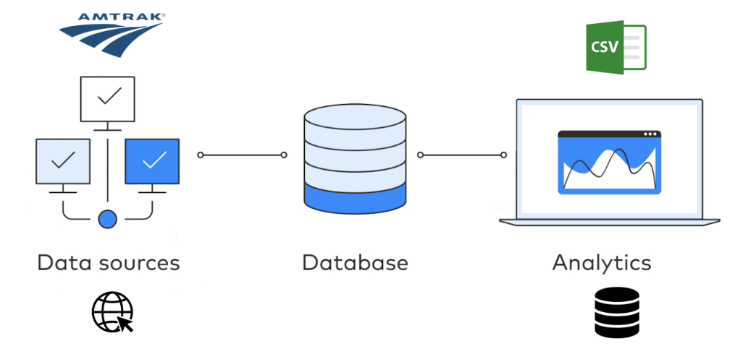
DATA SOURCES

Slide 5
INTRODUCTION

Slide 6
MISSION OBJECTIVE
The mission is to analyze Amtrak’s last 3 years data to provide insights and
recommendations on budgeting and costs using on-time performance, and ridership for
various stations across cities. To analyze performance, recommendations and story tell
using intuitive visualizations and data-driven decisions.
MISSION STATEMENTS
Identify key metrics such as on-time performance by route and station.
Analyze ridership trends across different stations and routes, focusing on high-traffic locations.
Determine procurement spending distribution by city and category to assess impact.
Track employment spends in various states and analyze key metrics.

Slide 7
CONCEPTUAL DATABASE DESIGN

Slide 8
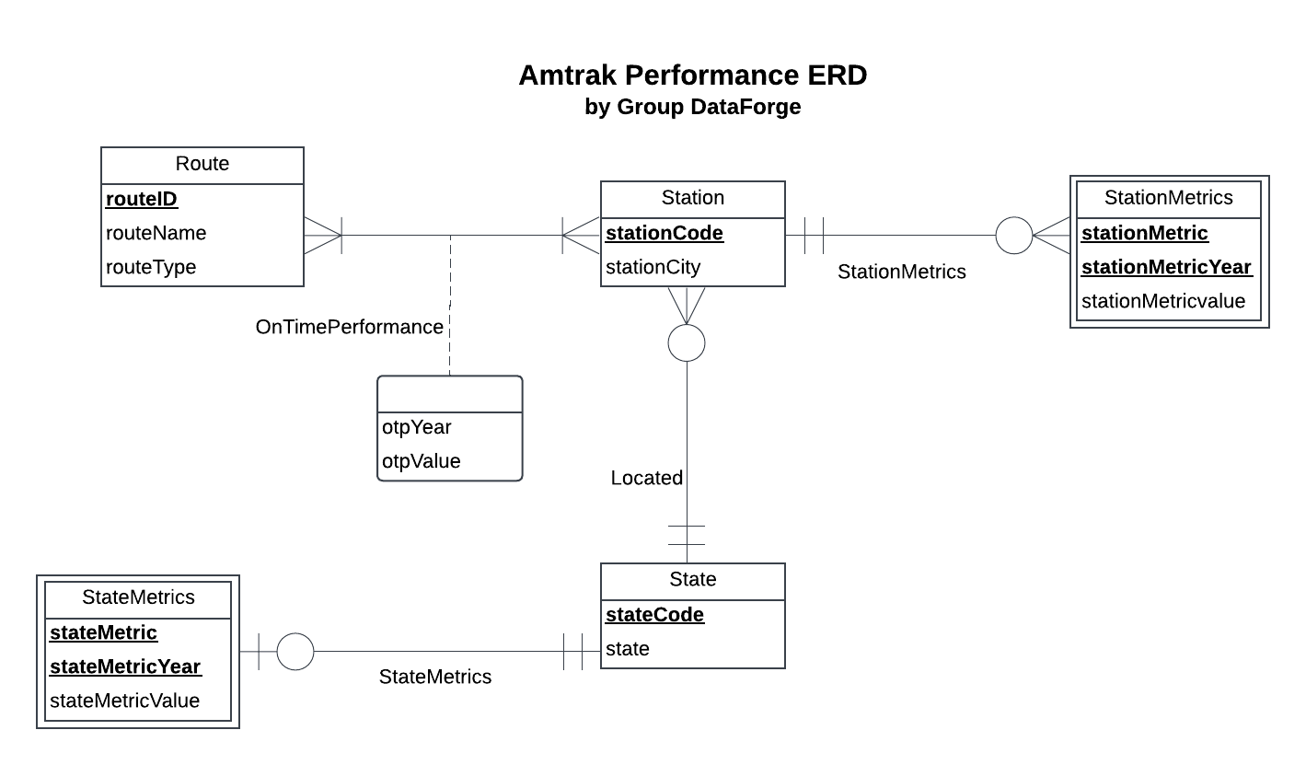
ER DIAGRAM

Slide 9
LOGICAL DATABASE DESIGN

Slide 10
RELATIONAL SCHEMA
State (stateCode, state)
Station (stationCode, stationCity, stateCode)
StateMetrics (stateCode, stateMetric, stateMetricYear, stateMetricValue)
StationMetrics (stationCode, stationMetric, stationMetricYear, stationMetricValue)
Route (routeID, routeName, routeType)
OnTimePerformance (routeID, stateCode, otpYear, otpValue)

Slide 11
PHYSICAL DATABASE DESIGN

Slide 12
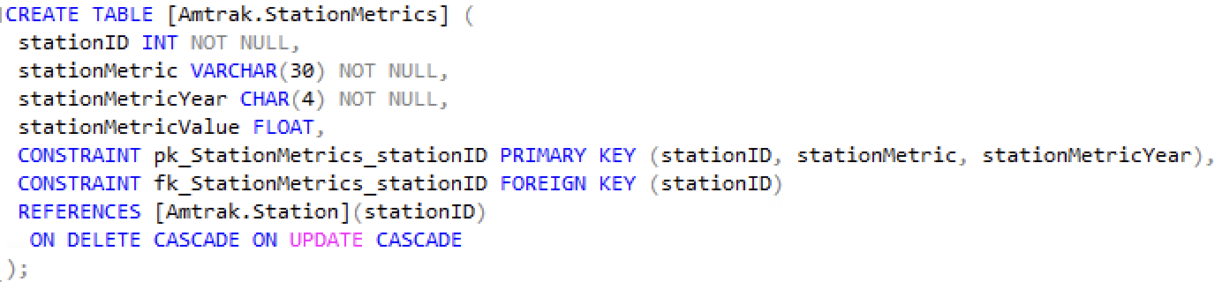
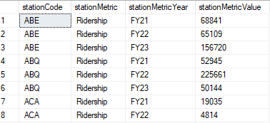
CREATE TABLE

Slide 13
BUSINESS TRANSACTIONS

Slide 14
How has the on time performance for stations and routes in California changed over the past three years?
SELECT o.otpYear AS 'Fiscal Year', AVG(o.otpValue*100) AS 'Average On-Time-Performance of California'
ORDER BY o.otpYearePerformance] o
JOIN [Amtrak.State] s ON o.stateCode = s.stateCode
WHERE s.stateCode = 'CA'
GROUP BY o.otpYear
ORDER BY o.otpYear;

Slide 15
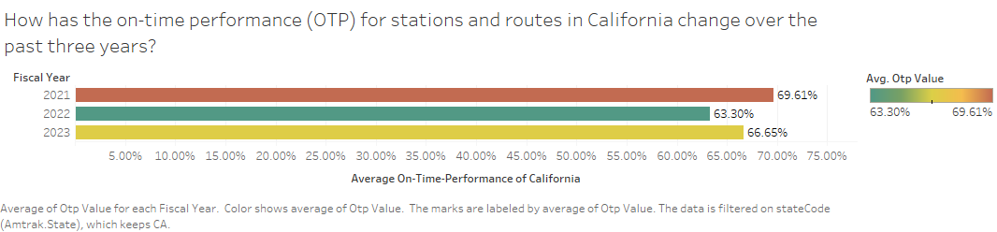
How has the on time performance for stations and routes in California changed over the past three years?

Slide 16
Observations
We can observe that the on time performance for stations at California were at peak in the year 2021
The on time performance took a dip in the following year and was the lowest among the three years. A gradual increase in the year 2023 is observed
Suggestions
Analyze the procurement spending for the state of California throughout the years
Review utilization and employment spending.
Optimize staff allocations and deployment.

Slide 17
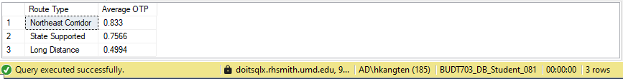
What is the average on time performance values for the 3 types of routes
SELECT o.otpYear AS 'Fiscal Year', AVG(o.otpValue*100) AS 'Average On-Time-Performance of California'
ORDER BY o.otpYearePerformance] o
JOIN [Amtrak.State] s ON o.stateCode = s.stateCode
WHERE s.stateCode = 'CA'
GROUP BY o.otpYear
ORDER BY o.otpYear;

Slide 18
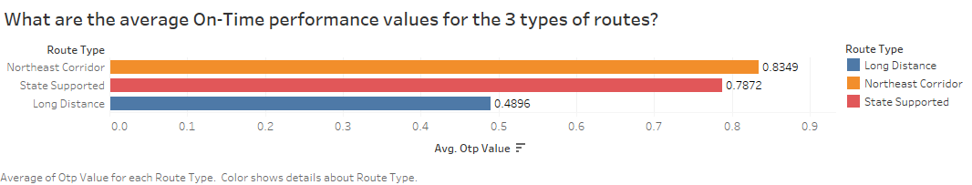
What is the average on time performance values for the 3 types of routes

Slide 19
What is the average on time performance for route types?
SELECT r.routeType AS 'Route Type', ROUND(AVG(o.otpValue),4) AS 'Average OTP'
ORDER BY ROUND(AVG(o.otpValueOIN [Amtrak.OnTimePerformance] o
ON r.routeId = o.routeId
GROUP BY r.routeType
ORDER BY ROUND(AVG(o.otpValue),2) DESC

Slide 20
Which budget type received the highest allocated budget in each year?
WITH YearlyBudget AS
( SELECT b.budgetPlanYear AS Budget_Year,
b.budgetType AS Budget_Type,
SUM(ab.allocatedBudget) AS Total_Allocated_Budget
FROM [Amtrak.Budget] b JOIN [Amtrak.AllocatedBudget] ab
ON b.budgetYearID = ab.budgetYearID
GROUP BY b.budgetPlanYear, b.budgetType ),
HighestBudgetPerYear AS
( SELECT Budget_Year, Budget_Type, Total_Allocated_Budget,
RANK() OVER (PARTITION BY Budget_Year ORDER BY Total_Allocated_Budget DESC) AS BudgetRank
FROM YearlyBudget )
SELECT Budget_Year, Budget_Type,
Total_Allocated_Budget
FROM HighestBudgetPerYear
WHERE BudgetRank = 1
ORDER BY Budget_Year ASC;

Slide 21
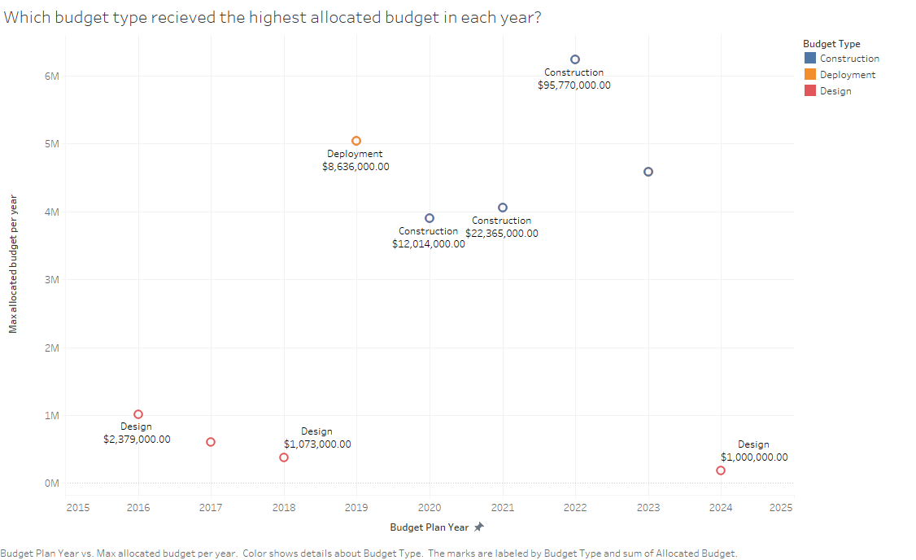
Which budget type received the highest allocated in each year?

Slide 22
THANK YOU

